Slide 1
NoSQL Databases (18CS823)
Presenter:
Mrs. Ancy Thomas
Assistant Professor
Department of Computer Science and Engineering
Acharya Institute of Technology

Slide 2
NoSQL Databases: Aggregated DBs
Module 1

Slide 3
NoSQL databases: Aggregated DBs
NoSQL data models
Key-value, document, column databases
Distribution models
Consistency
Map-Reduce
3

Slide 4
NoSQL: Aggregate data models
Besides Graph databases other three categories are widely used in the NoSQL ecosystem to classify data models adopted by NoSQL solutions:
key-value
document
column-family
They share a common characteristic of their data models which we will call aggregate orientation[SaFo13]
Aggregate is a term that comes from Domain-Driven Design (DDD) (http://dddcommunity.org/). In DDD, an aggregate is a collection of related objects that we wish to treat as a unit. In particular, it is a unit for data manipulation and management of consistency
4

Slide 5
Aggregate data models
The relational model divides the information that we want to store into tuples (rows): this is a very simple structure for data (which somehow is the key of the success of the relational model and the cause of the relational dominance we experienced from the late 70s to the first years of 2000s)
Aggregate orientation takes a different approach. It recognizes that often you want to operate on data in units that have a more complex structure.
It can be handy to think in terms of a complex record that allows lists and other record structures to be nested inside it
As well see, key-value, document, and column-family databases all make use of this more complex record.
However, there is no common term for this complex record; according to [SaFo13] we use here the term aggregate.
5

Slide 6
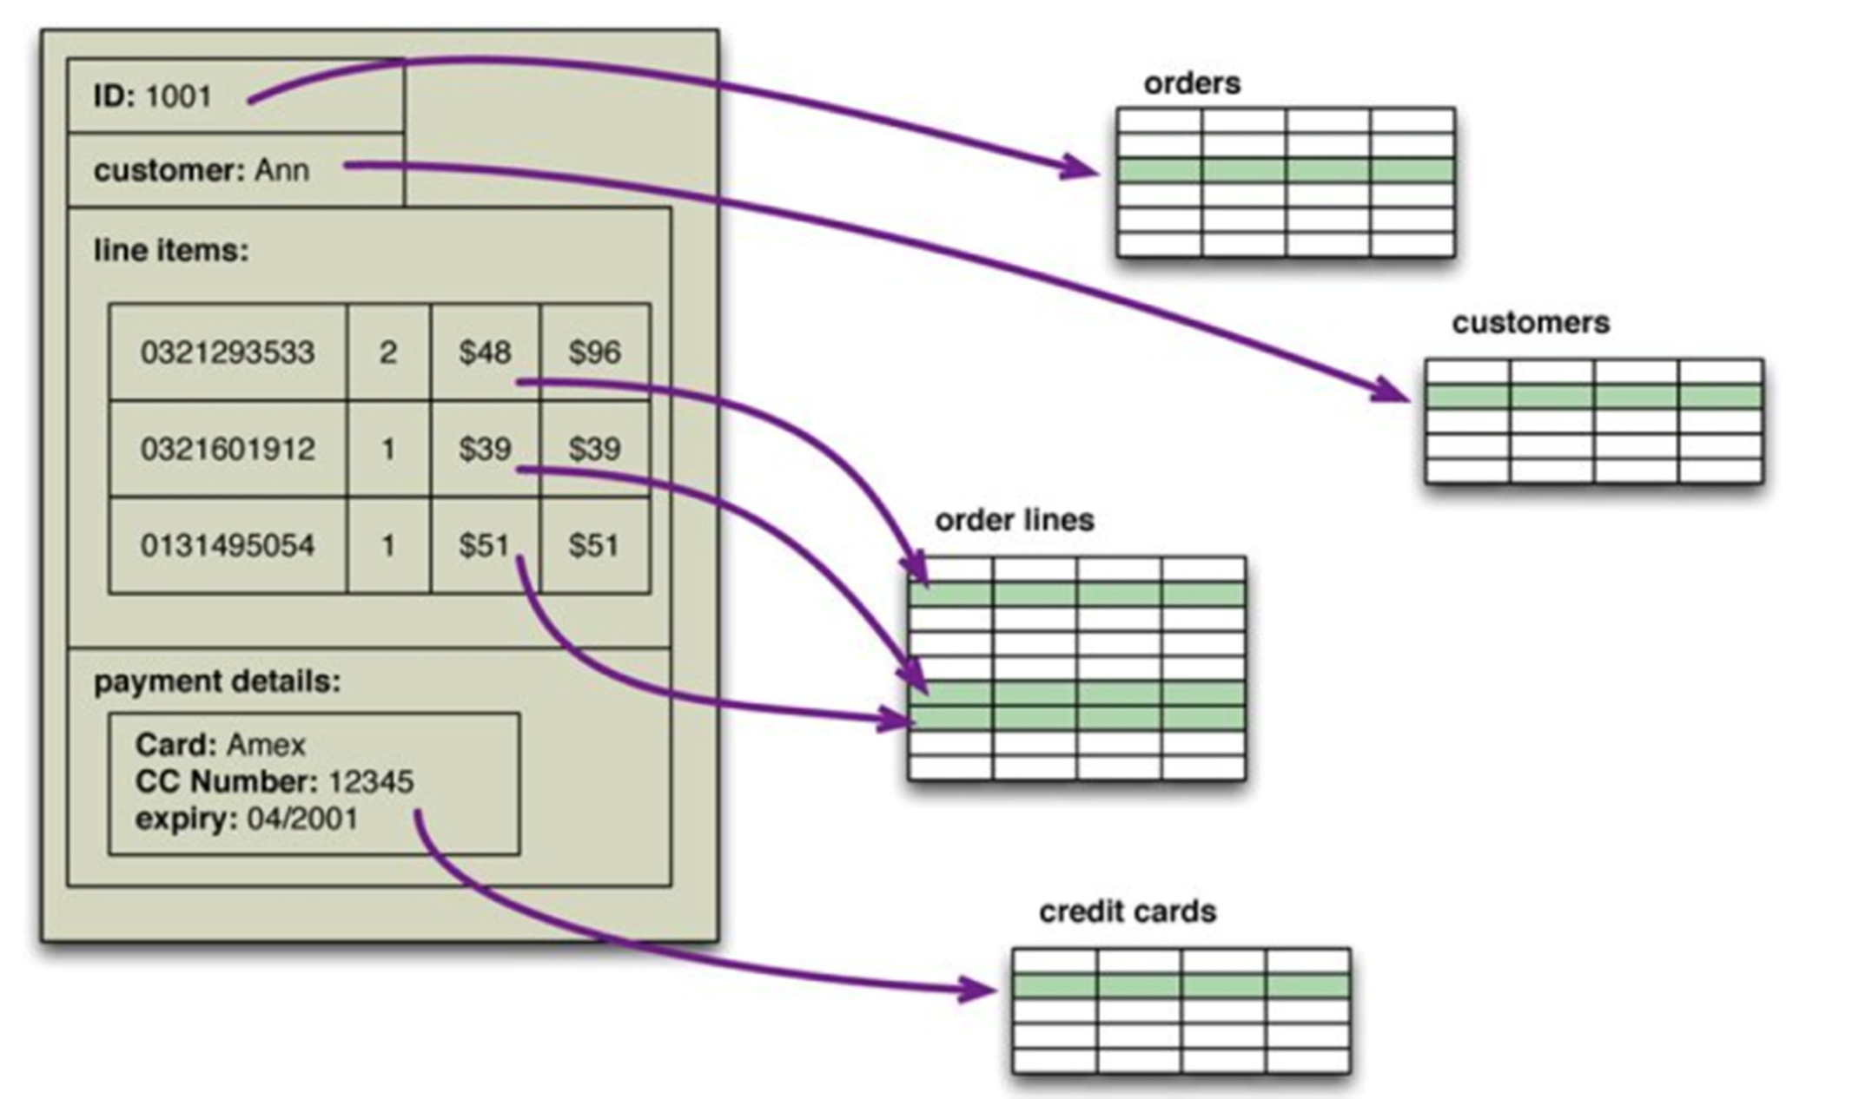
Aggregate data models
An order, which looks like a single aggregate
8

Slide 7
Aggregate data models
A natural question is now which are the main motivations at the basis of the rise of aggregate data models and tools supporting them
Some of them coincide with the motivations that originated the development of the Big Data ecosystem, and which we already discussed (recall the three v’s, etc.)
According to [SaFo13], two main aspects however should be emphasized:
Dealing with aggregates makes it much easier for these databases to handle operating on a cluster, since the aggregate makes a natural unit for replication and sharding
Also, it may help solving the impedance mismatch problem, i.e., the difference between the relational model and the in- memory data structures (see previous figure)
7

Slide 8
Attack of the clusters
The 2000s did see several large web properties dramatically increase in scale!
Websites started tracking activity and structure in a very detailed way. Large sets of data appeared: links, social networks, activity in logs, mapping data. With this growth in data came a growth in users
Coping with the increase in data and traffic required more computing resources
Scaling up implies bigger machines, more processors, disk storage, and memory. But bigger machines get more and more expensive, not to mention that there are real limits as your size increases
8

Slide 9
Attack of the clusters
The alternative is to scale out, i.e., use lots of small machines in a cluster. A cluster of small machines can use commodity hardware and ends up being cheaper at these kinds of scales.
It can also be more resilient while individual machine failures are common, the overall cluster can be built to keep going despite such failures, providing high reliability
As large properties moved towards clusters, that revealed a new problem: relational databases are not designed to be run on clusters!
9

Slide 10
Attack of the clusters
Relational databases could also be run as separate servers for different sets of data, effectively sharding the database, (i.e., data are physically segmented on various storage nodes)
While this separates the load, all the sharding has to be controlled by the application which has to keep track of which database server to talk for each bit of data
Also, we lose any querying, referential integrity, transactions , or consistency controls that cross shards
Deciding the granularity of sharding is a very difficult issue!
Aggregate orientation fits well with scaling out because the aggregate is a natural unit to use for distribution
On the other hand, NoSQL aggregate databases generally adopt a relaxed notion of consistency, with respect to the classical one used in the relation world which is based on ACID transactions. Also, slicing aggregates for more fine grained access to them may become
very difficult
12

Slide 11
Impedance mismatch
The impedance mismatch is a major source of frustration to application developers, and in the 1990s many people believed that it would lead to relational databases being replaced with databases that replicate the in- memory data structures to disk
That decade was marked with the growth of object-oriented programming languages, and with them came object-oriented databases
However, while object-oriented languages succeeded in becoming the major force in programming, object-oriented databases were not successful: Relational databases remained the major technology for data storage, being them highly consolidated, well-known, optimized, and, above all, based on standard language (SQL)
Thus, impedance mismatch remained an issue: Object-relational mapping frameworks like Hibernate or iBatis have been proposed that make it easier, but are not suited for those (frequent) scenarios in which many applications rely on the same (integrated) database. Also, query performance in general suffers under these frameworks .

Slide 12




Impedance mismatch - example
in-memory data structure
Actual data is stored in a DB:
D2[Code: Int, Salary: Int, SSN: String] Employee’s Code with salary and SSN
D1[Code: Int, PrName: String] Employees and Projects they work for
Conceptually:
An Employee is identified by her SSN.
A Project is identified by its name. Thus,
an employee should be created from her SSN;
a project should be created from its PrName
Employee
SSN: String salary: Integer
1..*
worksFor
1..*
Project
prName: String

Slide 13

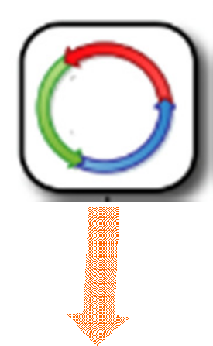

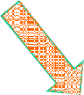

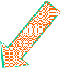
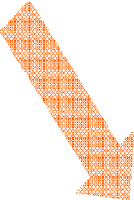


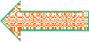



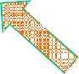

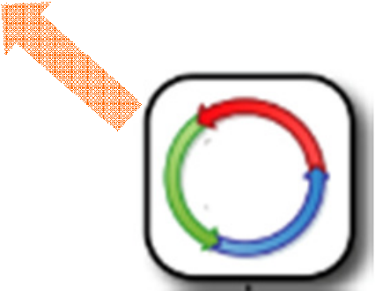
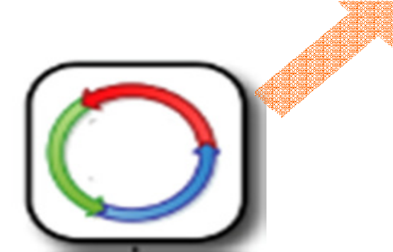
SQL as an integration mechanism
The primary factor that made relational databases more successful over OO databases is probably the role played by SQL as an integration mechanism between applications
In this scenario, multiple applications store their data in a common, integrated database. This improves communication because all the applications are operating on a consistent set of persistent data

Slide 14
Integration vs application databases
There are downsides to shared database integration
A structure that is designed to integrate many applications ends up being more complex
Changes to data by different applications need to be coordinated
different applications have different performance needs, thus call for different index structures
complex access control policies
A different approach is to treat your database as an application database

Slide 15
Application databases
An application database is only directly accessed by a single application, which makes it much easier to maintain and evolve
Interoperability concerns can now shift to the interfaces of the application:
During the 2000s we saw a distinct shift to web services, where applications would communicate over HTTP (cf. work on Service-oriented Architecture).
If you communicate with SQL, the data must be structured as relations. However, with a service, you are able to use richer data structures, possibly with nested records and lists.
These are usually represented as documents in XML or, more recently, JSON (JavaScript Object Notation), a lightweight data-interchange format.

Slide 16
Application databases
Since using application databases there is a decoupling between your internal database and the services with which you talk to the outside world, the outside world doesn’t have to care how you store your data, allowing you to consider nonrelational options
Furthermore, there are many features of relational databases, such as security, that are less useful to an application database because they can be done by the enclosing application instead
Note: On the other hand, when each application has its own database, the risk arises that data may become non-aligned, mutually inconsistent, and difficult to access in an integrated fashion. All these aspects should be indeed managed at the application level, which does not always take care of them.

Slide 17
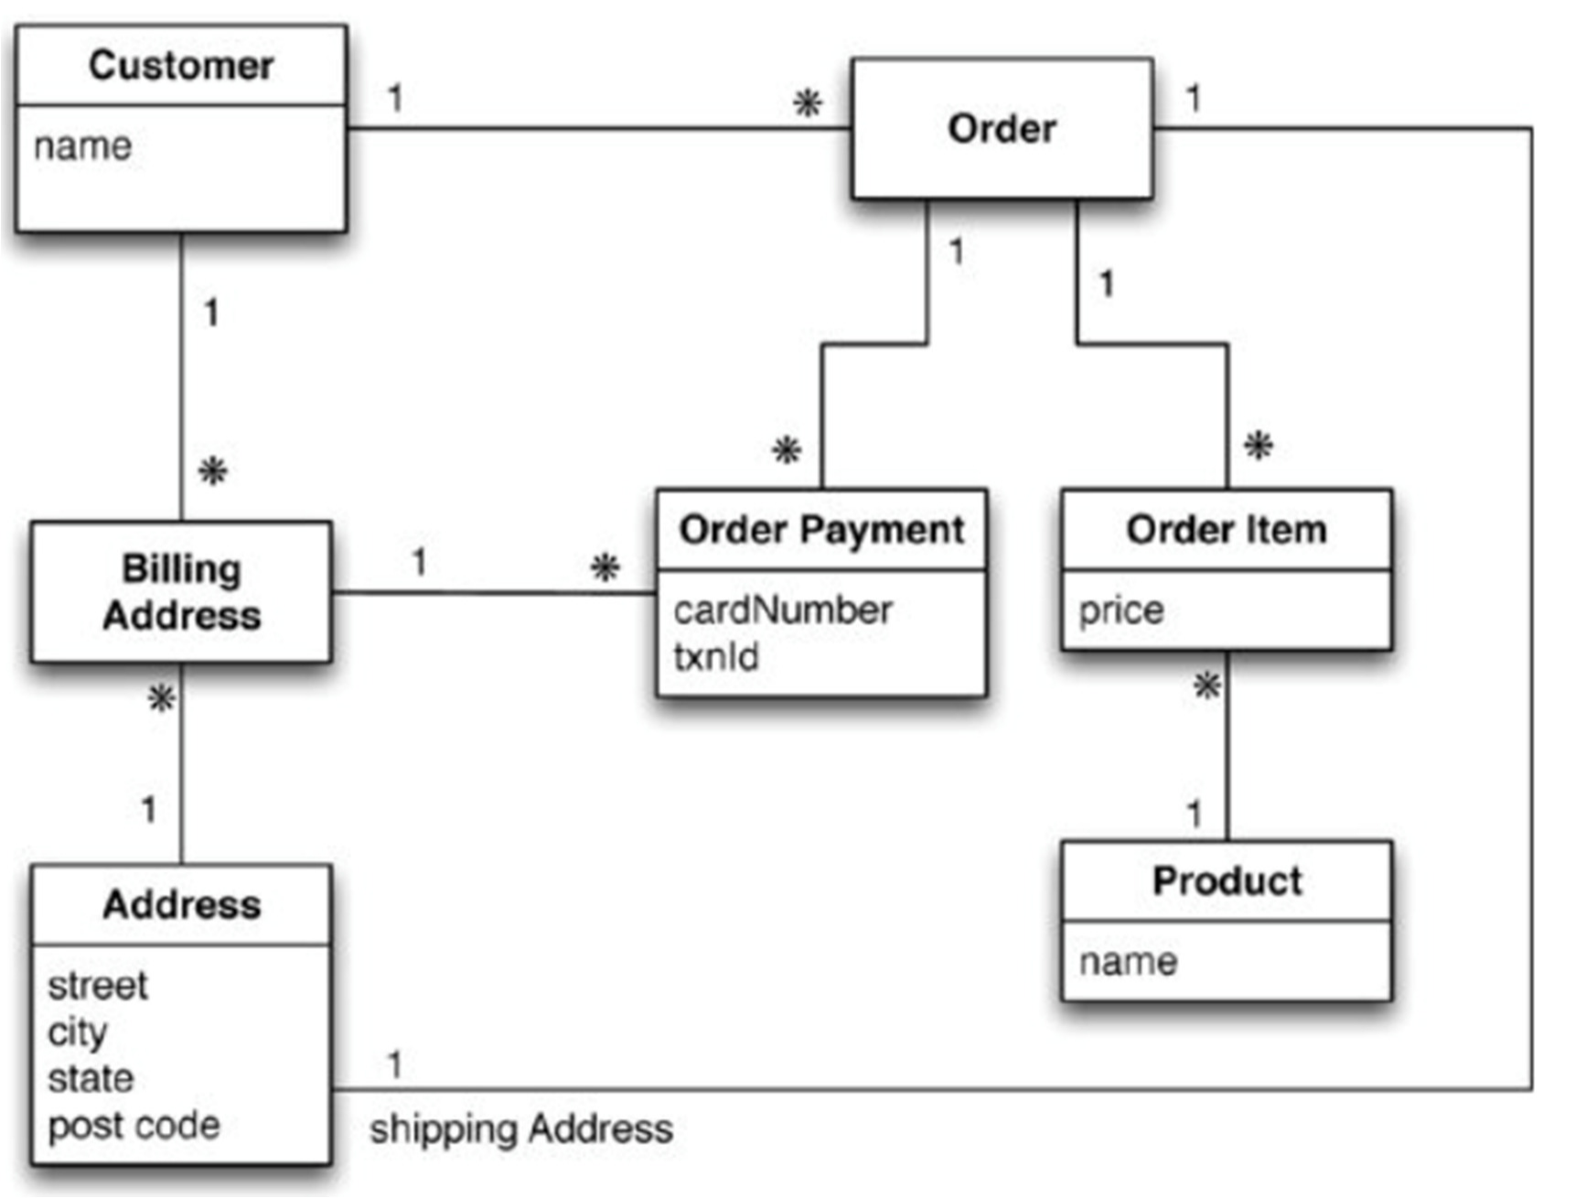
Example of Relations and Aggregates
*
Relational database perspective: no aggregates
19

Slide 18
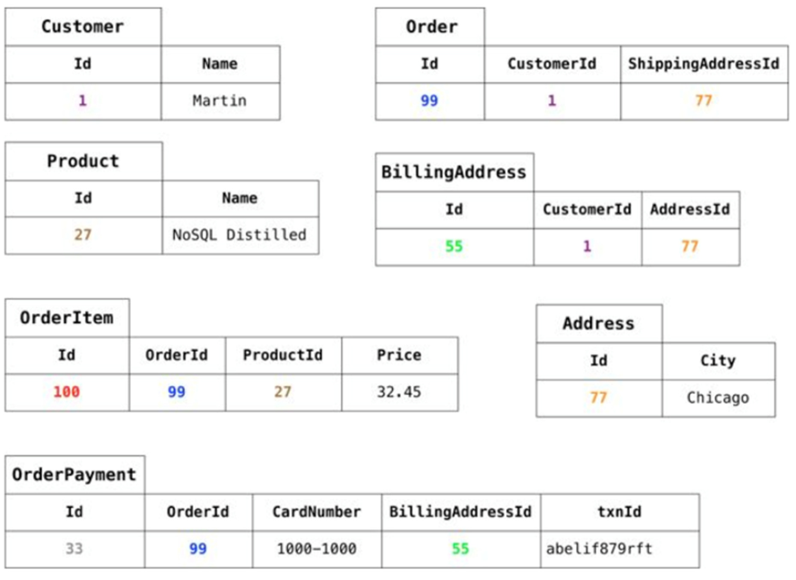
Example of Relations and Aggregates
Note: for simplicity, only interesting attributes for the instance at hand of the Address relation are represented. By default, each entity is assigned with a code
20

Slide 19
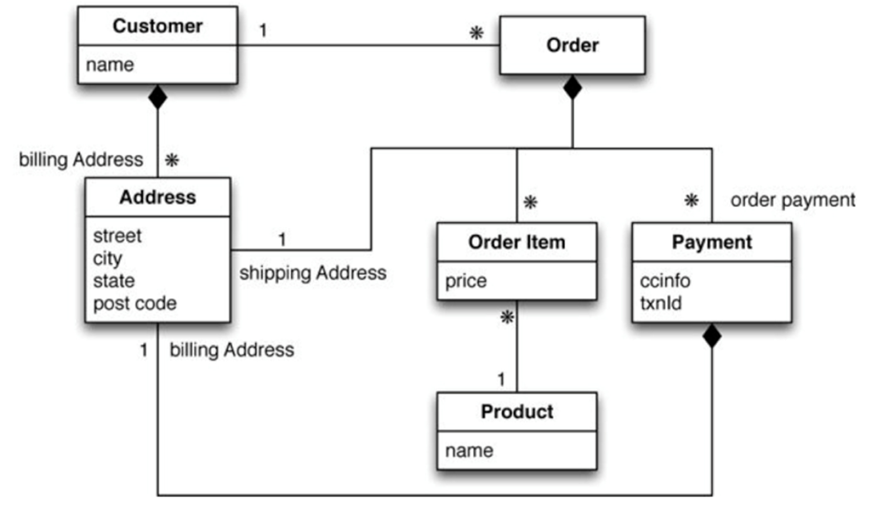
Example of Relations and Aggregates
Note: Address is strongly aggregated into Customer (implicit cardinality 0..1). Order is a strong aggregation of Address, OrderItem and Payment. Payment is a strong aggregation of Addresses (strong aggregation means that a single istance of Address is aggregated into a single instance of Customer, or Order, or Payment, but not in more than one)
21

Slide 20
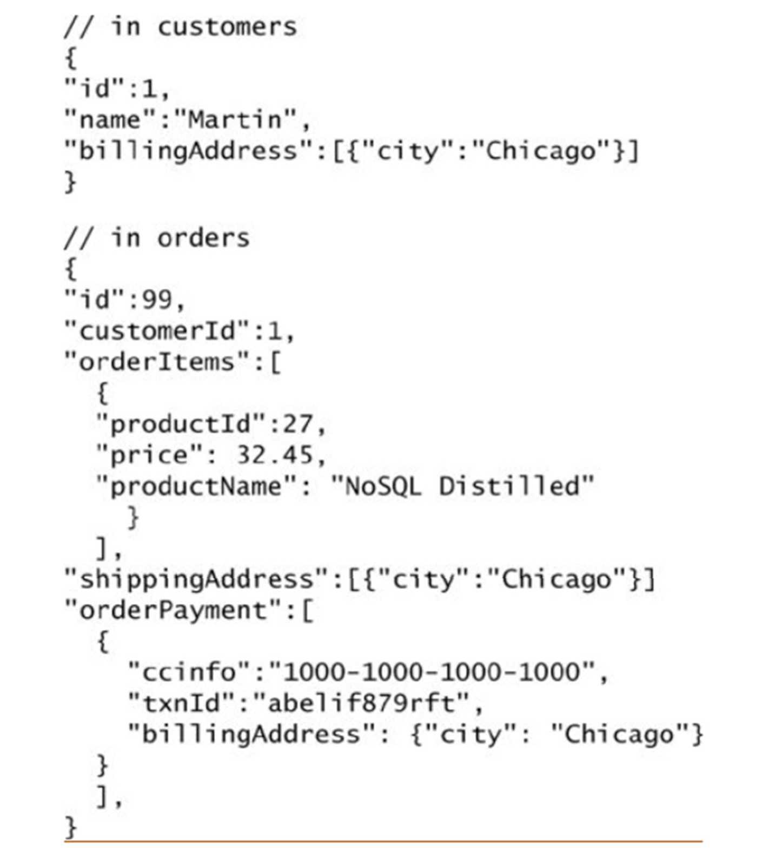
Example of Relations and Aggregates
There are two main aggregates:
customer and order
The customer contains a list of billing addresses and a name; the order contains a list of order items, a shipping address, and a list of payments. Each payment contains a billing address for that payment.
A single logical address record appears three times in the example data, but, instead of using IDs, it is treated as a value and copied each time.
The link between the customer and the order isn’t an aggregation.
However, we’ve shown the product name as part of the order to minimize the number of aggregates we access
during a data interaction
22

Slide 21
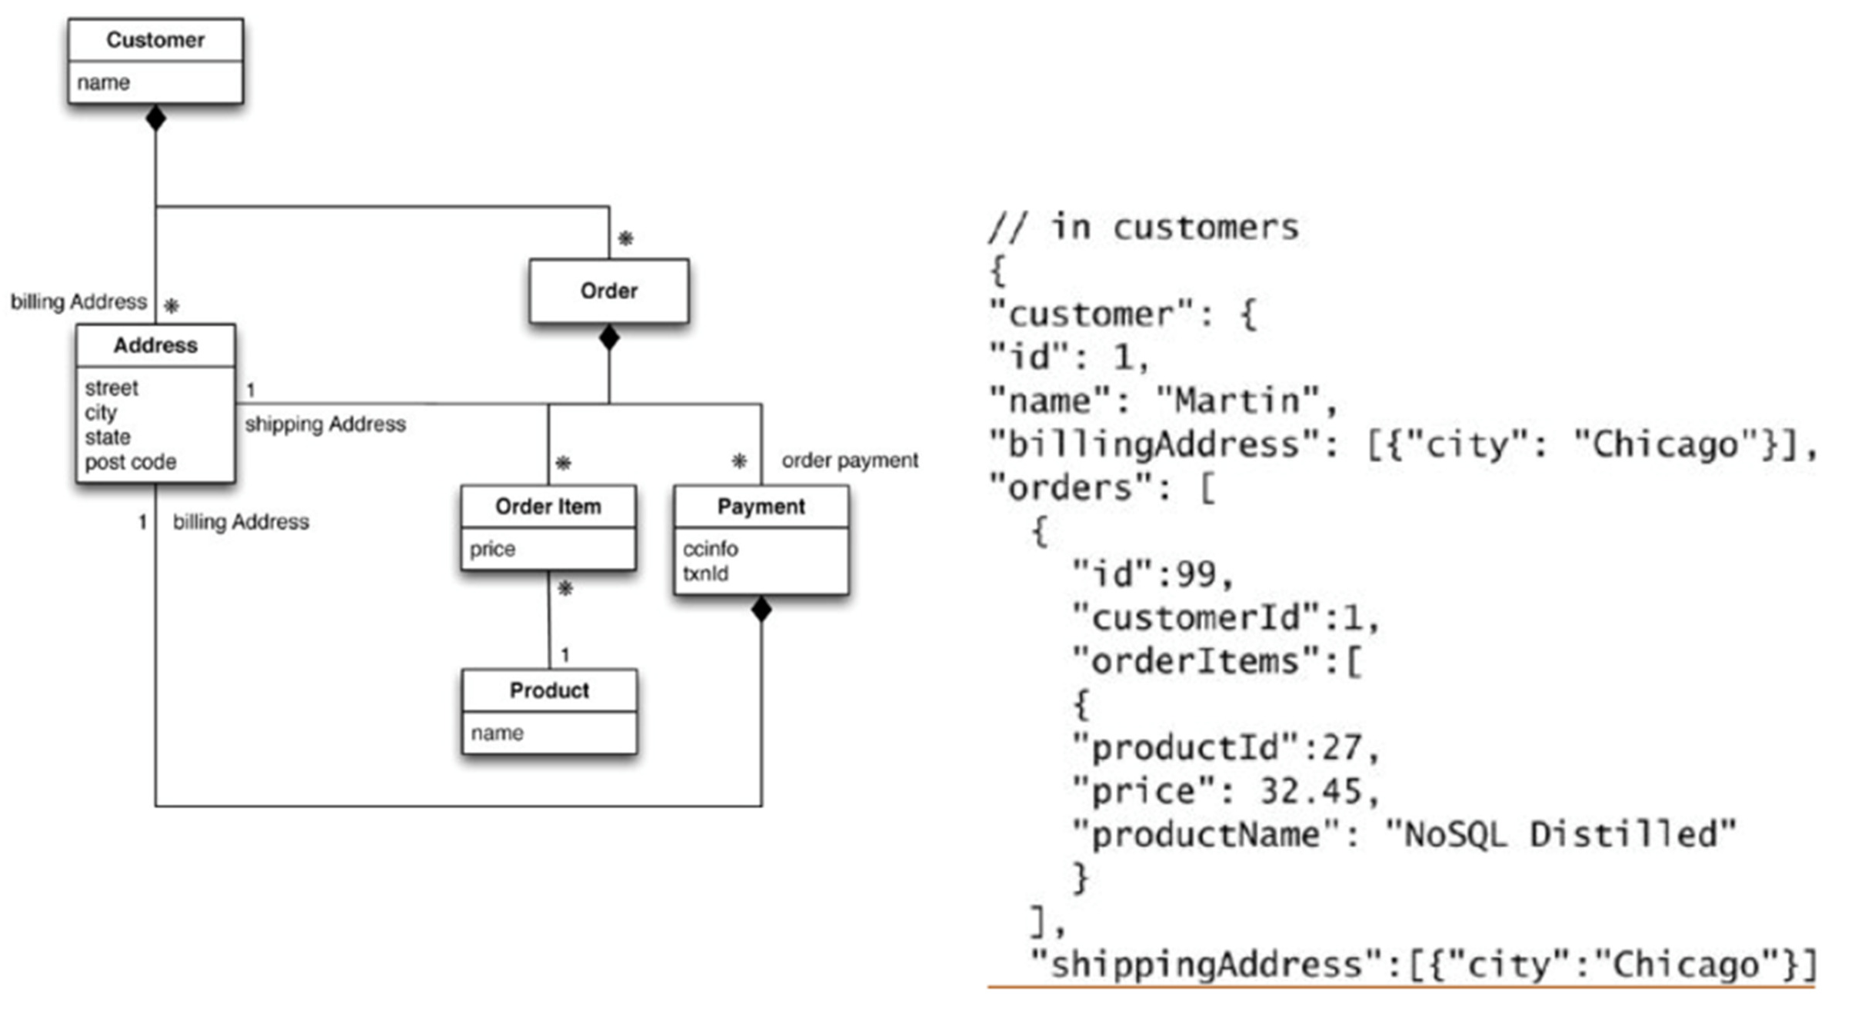
Example of Relations and Aggregates
....
An alternative way of aggregating data

Slide 22
Consequences of Aggregate Orientation
The fact that an order consists of order items, a shipping address, and a payment can be expressed in the relational model in terms of foreign key relationships but there is nothing to distinguish relationships that represent aggregations from those that don’t.
As a result, the database can’t use the knowledge about an aggregate structure to help it store and distribute the data
Aggregation is however, not a logical data property: It is all about how the data is being used by applications -- a concern that is often outside the boundary of data modeling
Also, an aggregate structure may help with some data interactions but be an obstacle for others (in our example, to get to product sales history, you’ll have to dig into every aggregate in the database)
The clinching reason for aggregate orientation is that it helps greatly with running on a cluster!

Slide 23
Consequences of Aggregate Orientation
Aggregates have an important consequence for transactions.
Relational databases allow you to manipulate any combination of rows from any tables in a single (ACID) transaction (i.e., Atomic, Consistent, Isolated, and Durable)
It’s often said that NoSQL databases don’t support ACID transactions and thus sacrifice consistency. This is however not true for graph databases (which are, as relational database, aggregate-agnostic)
In general, its true that aggregate-oriented databases don’t have ACID transactions that span multiple aggregates. Instead, they support atomic manipulation of a single aggregate at a time: This means that if we need to manipulate multiple aggregates in an atomic way, we have to manage that ourselves in the application code!
In practice, we find that most of the time we are able to keep our atomicity needs to within a single aggregate; indeed, that is part of the consideration for deciding how to divide up our data into
aggregates
25

Slide 24
NoSQL databases: Aggregated DBs
NoSQL data models
Key-value, document, column databases
Distribution models
Consistency
Map-Reduce

Slide 25
Key-Value and Document Data Models
Key-value and Document databases were strongly aggregate-oriented
In a key-value database, the aggregate is opaque to the database: just some big blob of bits.
The advantage of opacity is that we can store whatever we like in the aggregate.
It is the responsibility of the application to understand what was stored. Since key-value stores always use primary-key access, they generally have great performances, Descended as they are from Amazon’s Dynamo database—a platform designed for a nonstop shopping cart service—Key-values stores essentially act like large, distributed hashmap data structures.
25

Slide 26
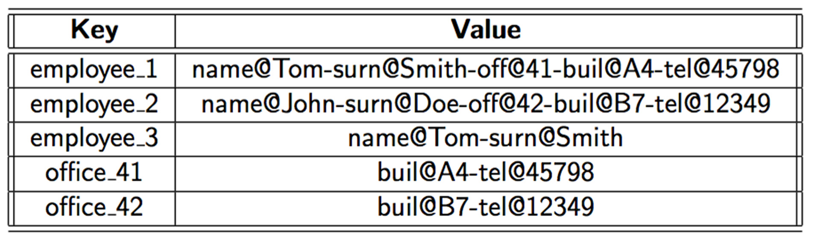
Key-Values: example

Slide 27
Key-Value and Document Data Models
In contrast, a document database is able to see a structure in the aggregate, but imposes limits on what we can place in it, defining allowable structures and types.
In return, however, more flexibility when accessing data.
27

Slide 28
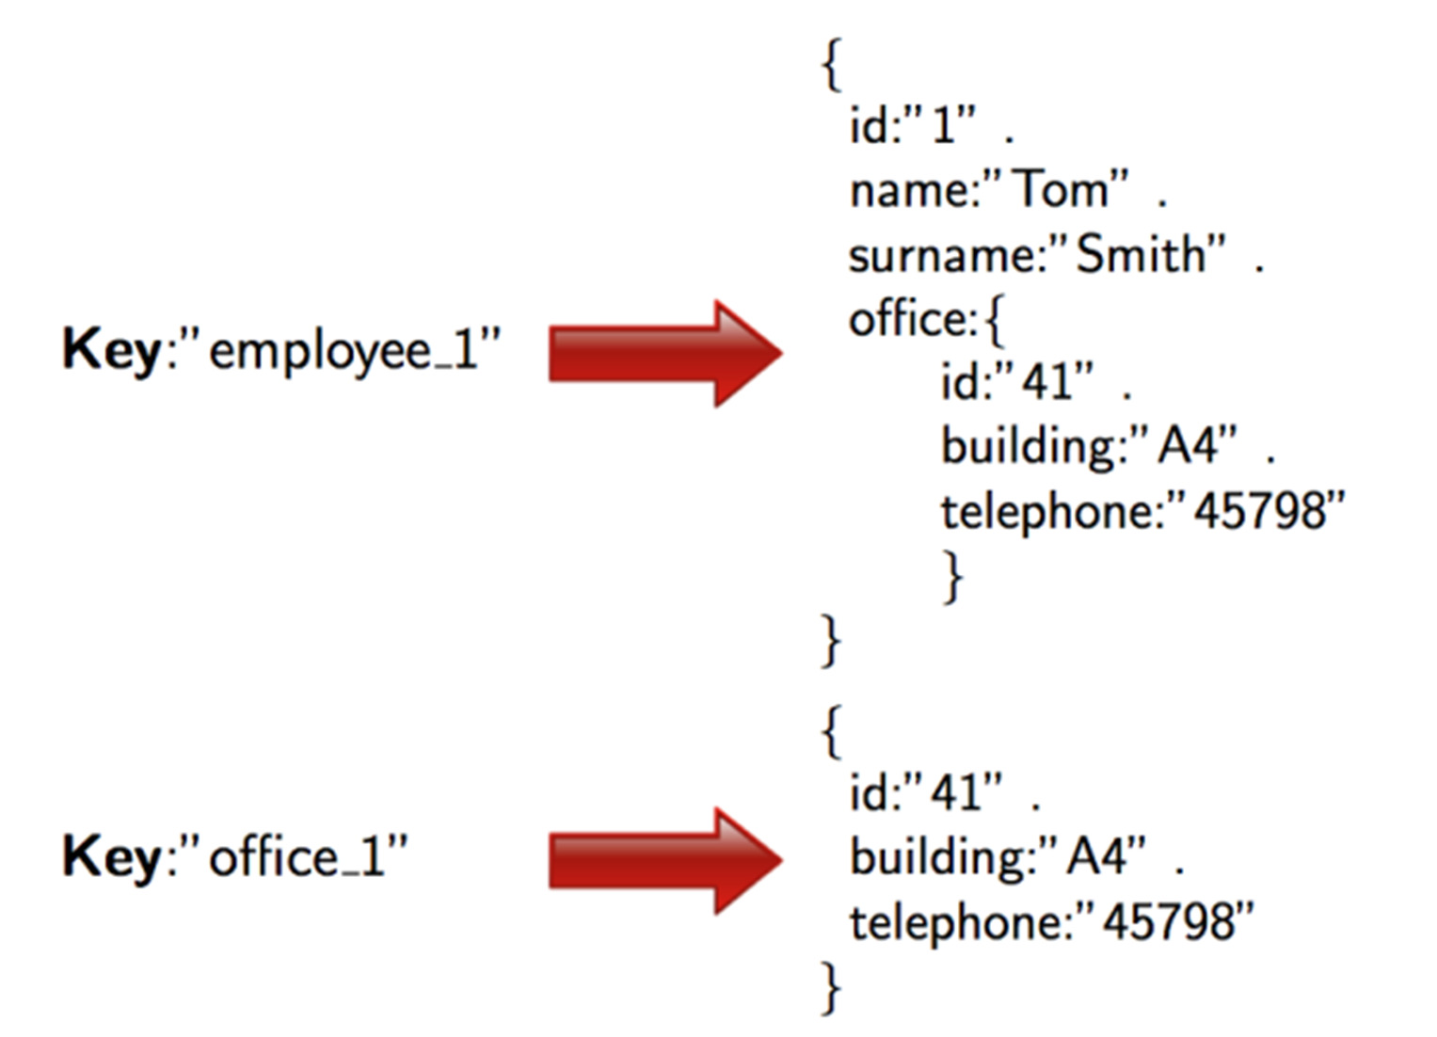
Documents: example (JSON format)

Slide 29
Key-Value and Document Data Models
With a key-value store, we can only access an aggregate by lookup based on its key
At the simplest level, even in document databases documents can be stored and retrieved by ID (as key-values stores). however, in general, we can submit queries to the database based on the fields in the aggregate, we can retrieve part of the aggregate rather than the whole thing, and the database can create indexes based on the contents of the aggregate. In general, indexes are used to retrieve sets of related documents from the store for an application to use.
As usual, indexes speed up read accesses but slow down write accesses, thus they should be designed carefully.

Slide 30
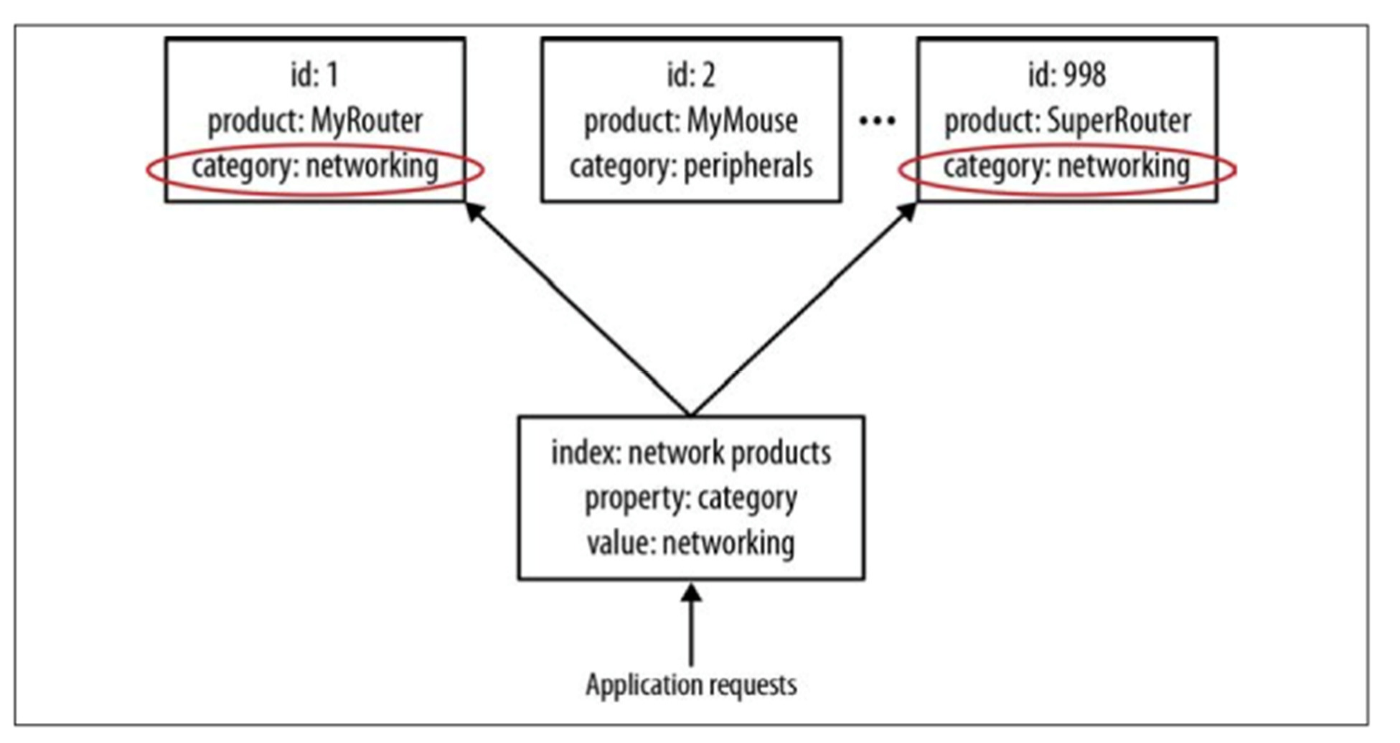
Indexes on Document Data Models
For example, in an ecommerce scenario, we might use indexes to represent distinct product categories so that they can be offered up to potential sellers.
31

Slide 31
Key-Value and Document Data Models
In practice, the line between key-value and document gets a bit blurry: People often put an ID field in a document database to do a key-value style look-up. Databases classified as key-value databases may allow you structures for data beyond just an opaque. For example, Redis allows you to break down the aggregate into lists or sets, Riak allows you to put aggregates into buckets.
Some of the popular key-value databases are Riak, Redis (often referred to as Data Structure server), Memcached DB, Berkeley DB, HamsterDB (especially suited for embedded use), Amazon DynamoDB (not open- source), Project Voldemort (an open-source implementation of Amazon DynamoDB)
Some of the popular document databases are MongoDB, CouchDB, Terrastore, OrientDB (which is also a graph DBMS), RavenDB, but also Lotus Notes, which adopts document storage.

Slide 32
Column Family Stores
Column family stores are modeled on Google’s BigTable. The data model is based on a sparsely populated table whose rows can contain arbitrary columns.
Some popular Column Family stores are Cassandra, Hbase, Hypertable, and Amazon SimpleDB
Note: These databases with a bigtable-style data model are often referred to as column stores, and not column family stores, but that name has been around for a while to describe a different object: Pre- NoSQL column stores, such as C-Store or MonetDB, were happy with SQL and the relational model. The thing that made them different was the way in which they physically stored data, based on columns rather than on rows as a unit for storage (this storage system is particularly suited to speed up read accesses)

Slide 33
Column Family Stores
The column-family model can be seen as a two-level aggregate structure
As with key-value stores, the first key is often described as a row identifier, picking up the aggregate of interest
This row aggregate is itself formed of a map of more detailed values. These second-level values are referred to as columns, each being a key-value pair
Columns are organized into column families. Each column has to be part of a single column family (data for a particular column family will be usually accessed together)
Each row identifier (i.e., first-level key) is unique in the context of a single Column Family.

Slide 34
Column Family Stores
Two ways to think about how the data is structured:
Row-oriented: Each row is an aggregate (for example, customer with the ID of 1234) with column families
representing useful chunks of data (profile, order history) within that aggregate
Column-oriented: Each column family defines a record type (e.g., customer profiles) with rows for each of the records. You then think of a row as the join of records in all column families. Column Families can be then to some extent considered as tables in RDBMSs. Unlike table in RDBMSs, a Column Family can have different columns for each row it contains

Slide 35
Column Family Stores: Cassandra
The terminology used so far is as established by Google Bigtable and HBase, but Cassandra looks at things slightly differently:
What we have called column family according to the Bigtable terminology is somehow equivalent to Cassandra supercolumns, i.e., columns that contain nested columns.
We can still use the term column family in Cassandra, and think of column families as tables, but now, each row in the table, besides possibly having different columns with respect to other rows, presents columns aggregated in supercolums. Also, a row in Cassandra only occurs in one column family.

Slide 36
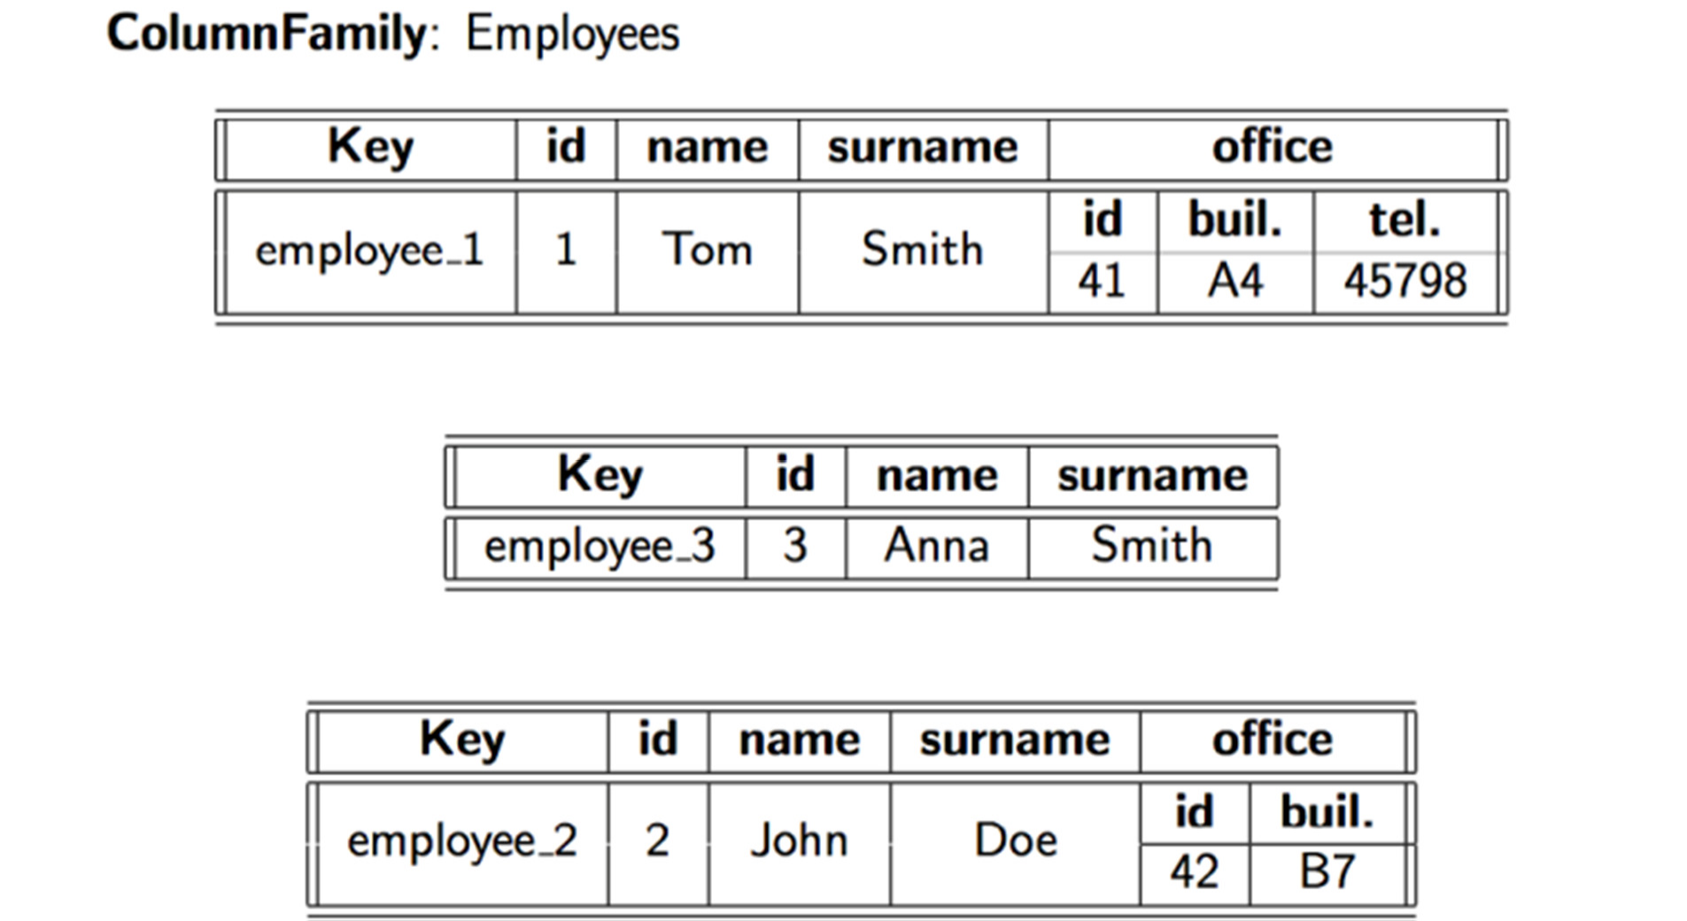
Column Family Stores:
Cassandra terminology

Slide 37
Aggregate DBs: Wrapping up
All aggregate data models are based on the notion of an aggregate indexed by a key that you can use for lookup. Within a cluser, all the data for an aggregate should be stored together on one node. The aggregate also acts as the atomic unit for management
The key-value data model treats the aggregate as an opaque whole (no access to portion of an aggregate is allowed). Great performances are allowed but the aggregate has to be understood at the application level
The document model makes the aggregate transparent, allowing you to do queries and partial retrievals. However, since the document has no schema, the database cannot act much on the structure of the document to optimize the storage
Column-family models divide the aggregate into column families, allowing the database to treat them as units of data within the row aggregate. This imposes some structure on the aggregate but allows the database to take advantage of that structure to improve its accessibility

Slide 38
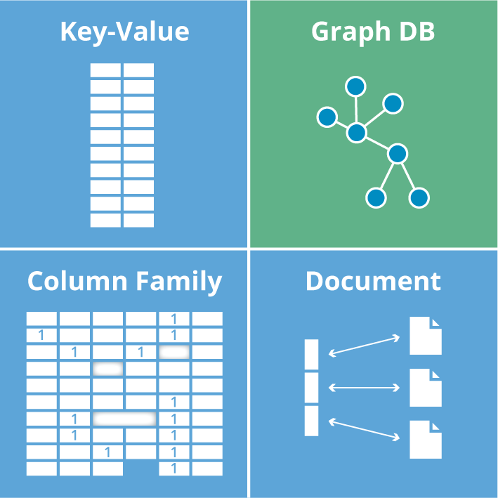
Chapter 2 - Aggregate Data Models

Slide 39
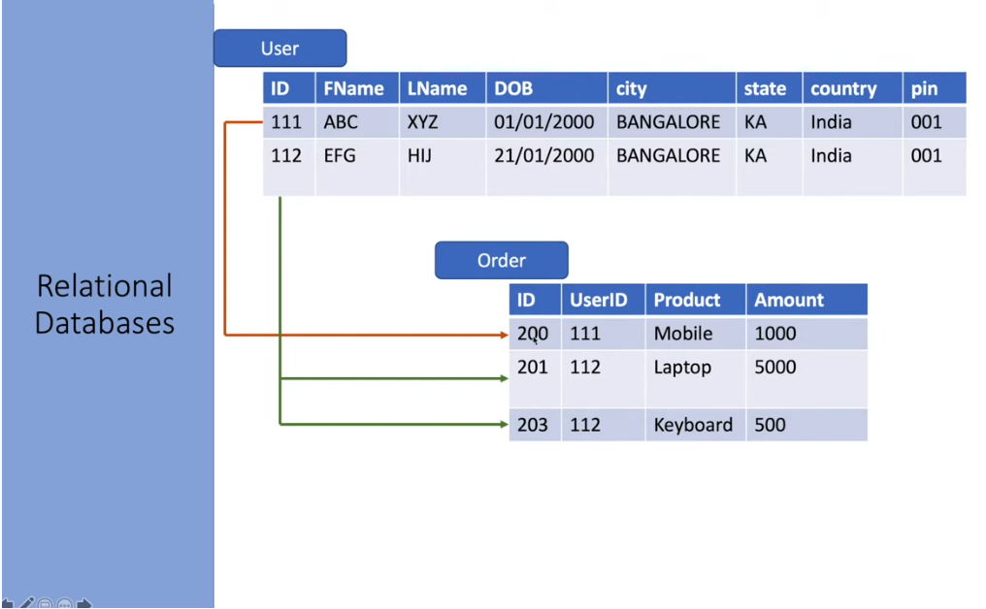

Slide 40
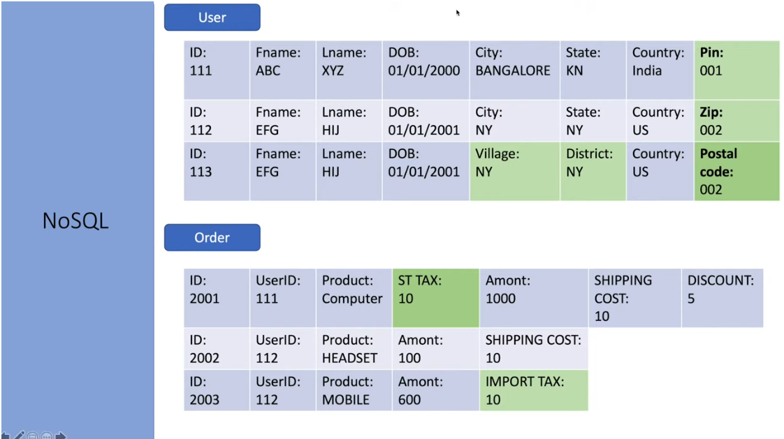

Slide 41
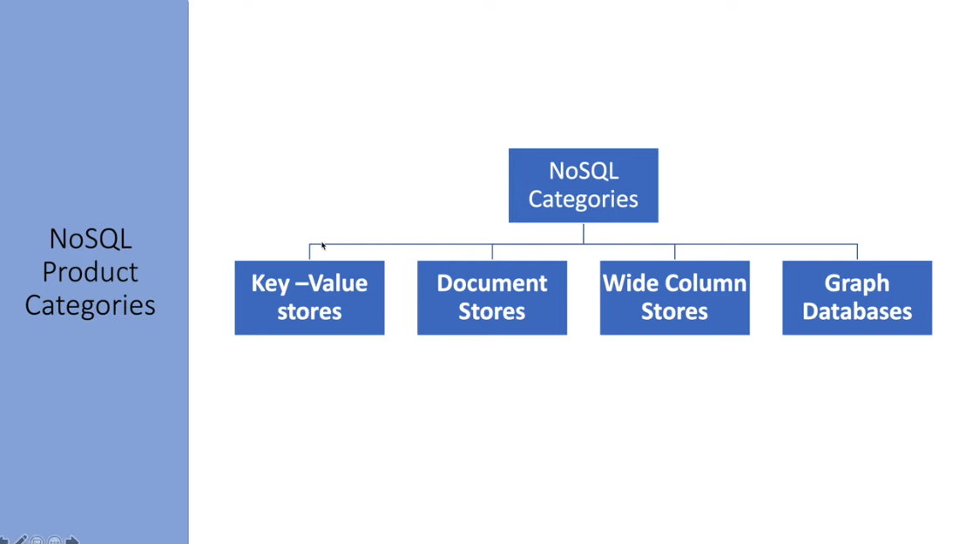

Slide 42
Non-relational database models can broadly be classified into four categories:
A key-value store allows you to store any type of data under a unique key.
A document database uses a similar approach by aggregating different data types within a single JSON or XML document.
Column-based bases store data under a column of your choice.
Graph databases establish edges and properties for nodes that represent data elements.

Slide 43
Key-Value Databases
Key-value databases, sometimes referred to as key-value stores, use the simplest data model – the pairing of a key and a value.
An application retrieves the value using the unique key.
The value can contain any data structure or type.
It is up to the application trying to access the data to understand the content.
Examples of key-value databases include Redis, Riak, Aerospike, and Oracle NoSQL.

Slide 44
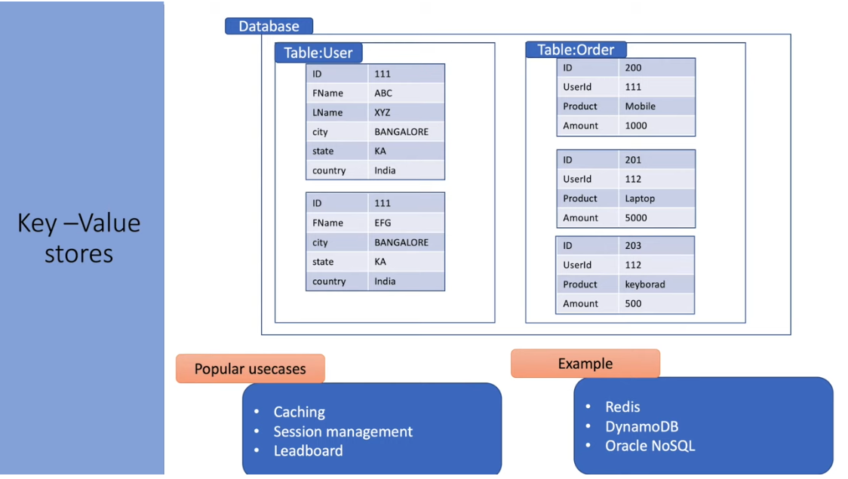

Slide 45
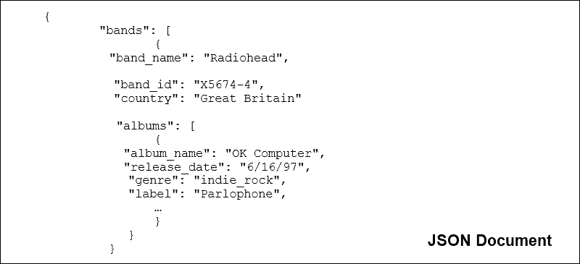
Document Databases
Document databases store partially structured data in documents, using JSON, BSON, XML, or other formats.
The data inside the document is semi-structured to provide more flexibility when querying.
Unlike basic key-value stores, the user does not need to retrieve the entire record, only the relevant part of the document.
Web-facing documents, user comments, and web-publishing apps all benefit from this data model.
Famous document-based NoSQLs are MongoDB, OrientDB, Apache CouchDB, and MarkLogic.

Slide 46
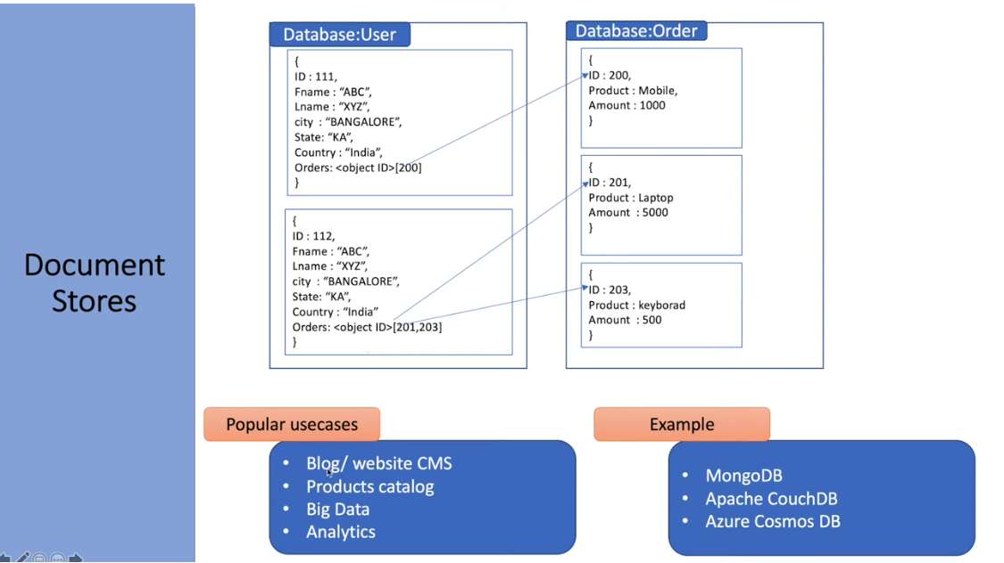

Slide 47
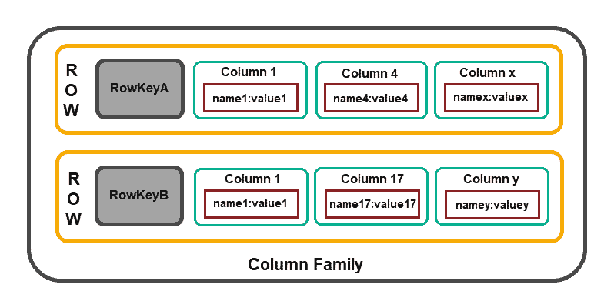
Column Family Stores
Column-based databases focus on the efficiency of read operations. If you need to read several columns of multiple rows quickly, it makes sense to organize data in groups of columns (i.e., column families).
The model structure consists of a row identifier that defines the aggregated data and the row aggregate that is composed of more detailed, secondary-level values (i.e., columns).
Cassandra, HBase, Amazon DynamoDB and Clickhouse

Slide 48
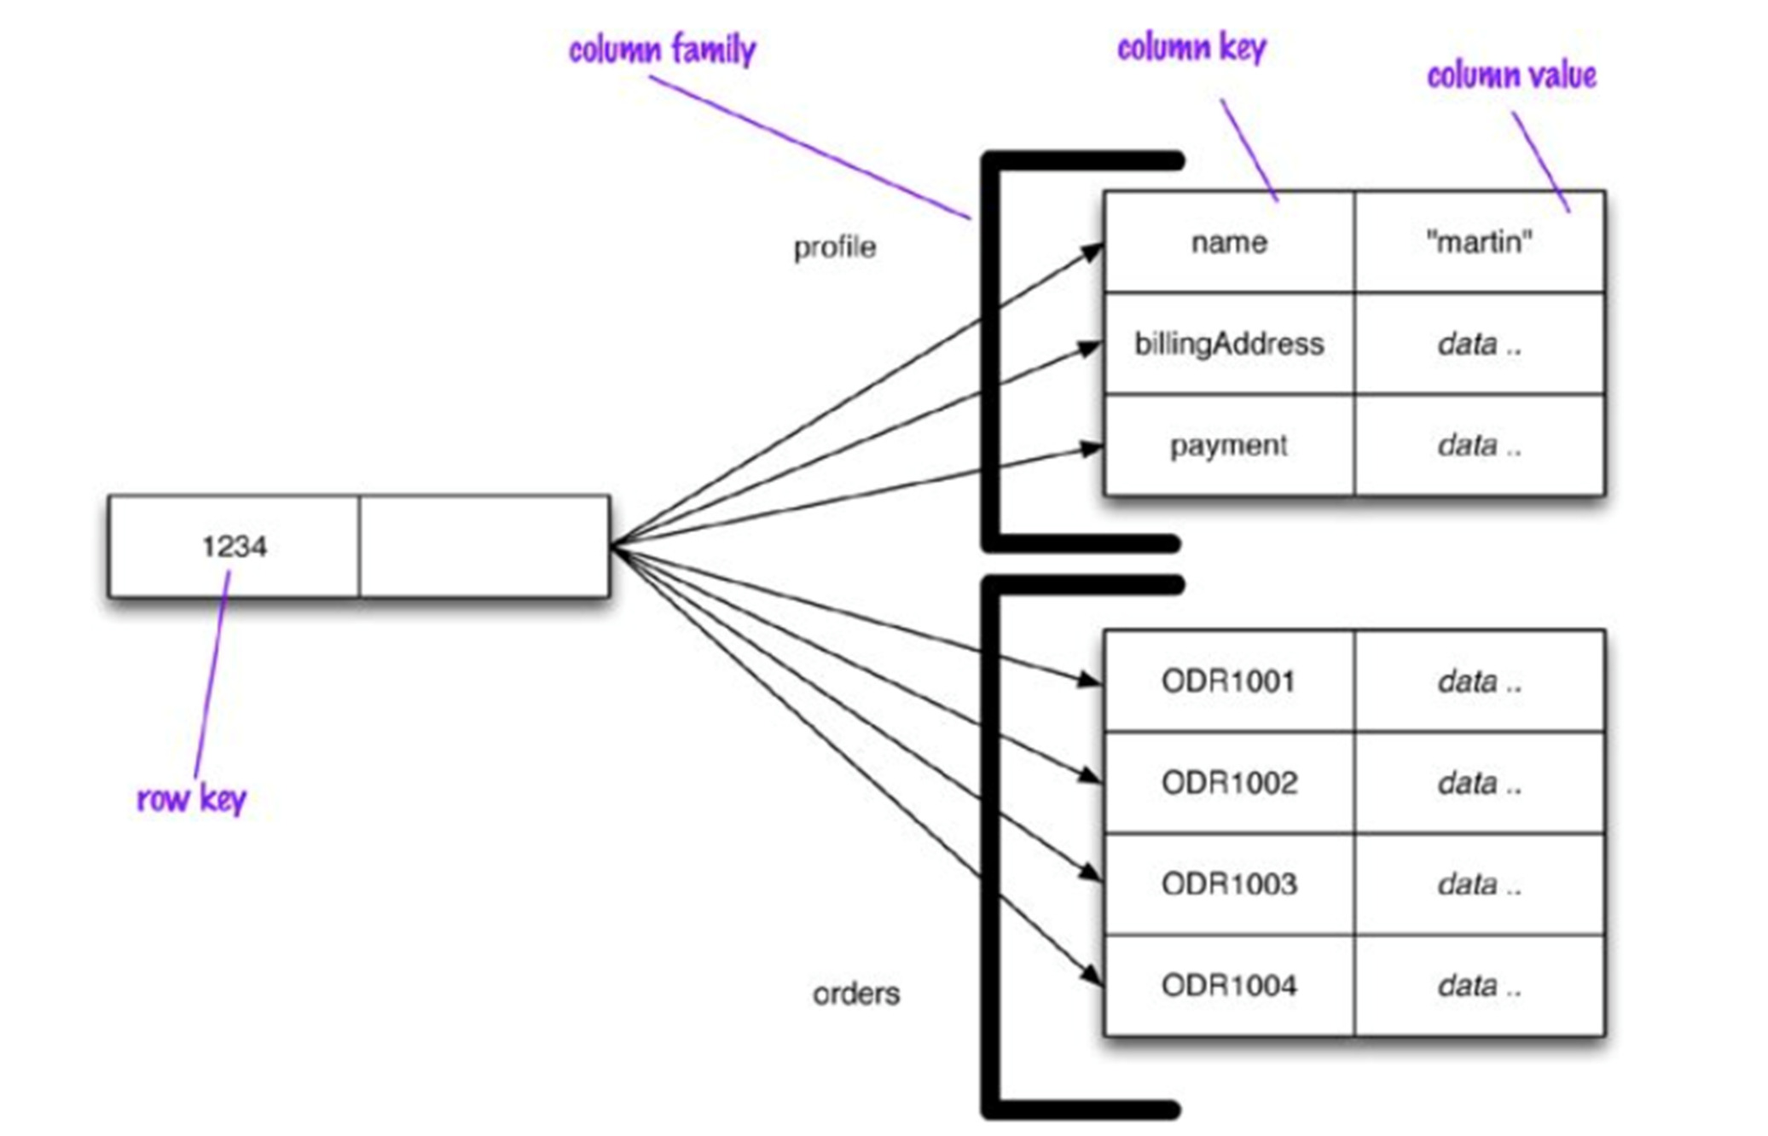
Column Family Stores

Slide 49
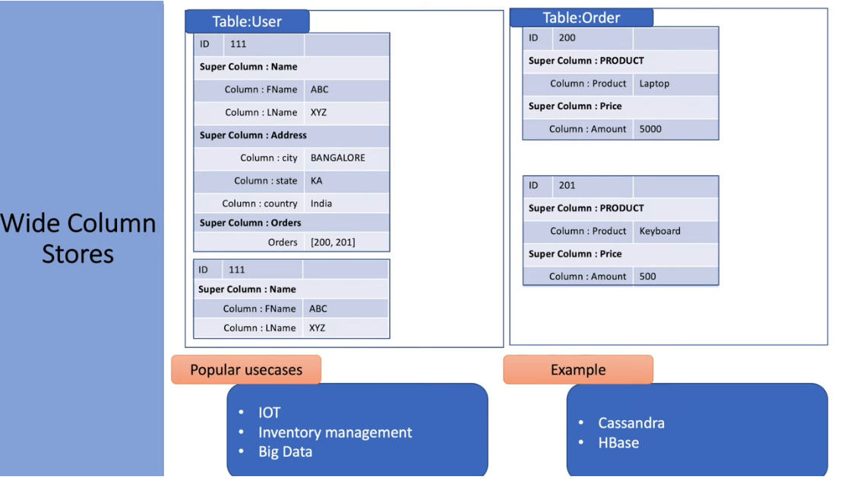

Slide 50
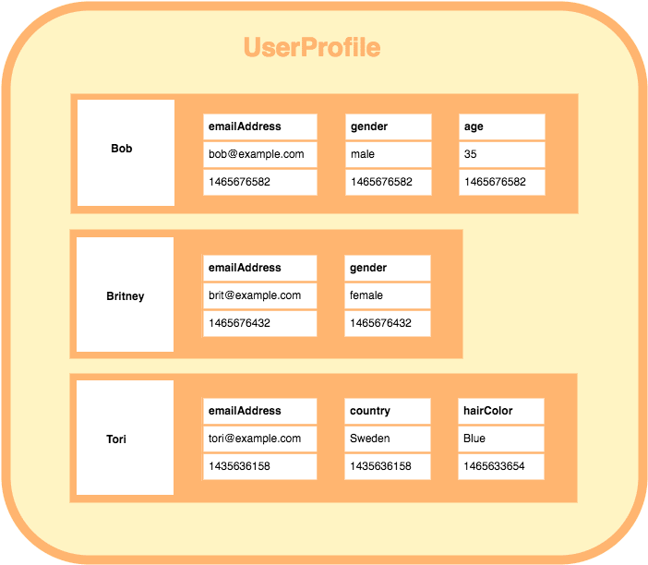

Slide 51
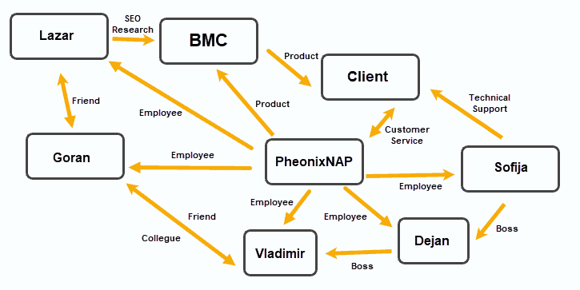
Graph Databases
Graph databases organize data into Nodes, with Edges establishing relationships between these data nodes.
This data storage model proved to be useful in applications that emphasize relationships, such as social media platforms, customer relations software, and travel and reservation systems.
Document-based OrientDB and MarkLogic can function as graph databases.
JanusGraph, RedisGraph, and Neo4j are popular graph-based solutions.

Slide 52
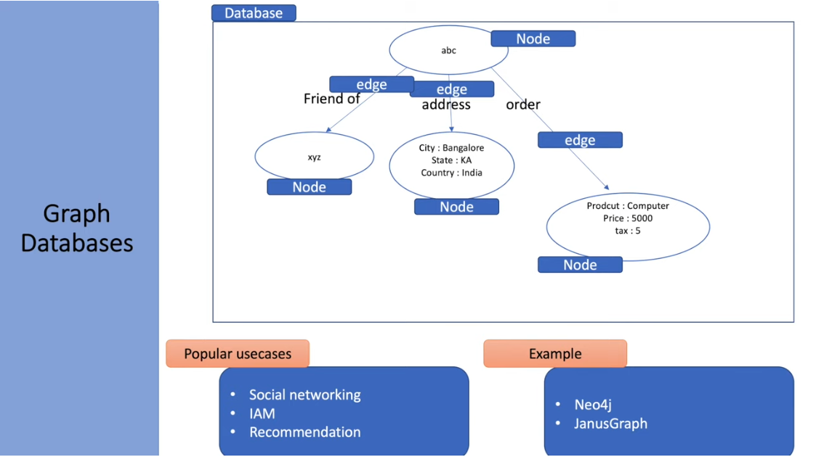

Slide 53
Schemaless databases
NoSQL databases are schemaless:
A key-value store allows you to store any data you like under a key.
A document database effectively does the same thing, since it makes no restrictions on the structure of the documents you store.
Column-family databases allow you to store any data under any column you like.
Graph databases allow you to freely add new edges and freely add properties to nodes and edges as you wish.
This has various advantages:
Without a schema binding you, you can easily store whatever you need, and change your data storage as you learn more about your project
You can easily add new things as you discover them
A schemaless store also makes it easier to deal with nonuniform data: data where each record has a different set of fields (limiting sparse data storage)

Slide 54
Schemaless databases
Schemalessness is appealing, but it brings some problems of its own
Indeed, whenever we write a program that accesses data, that program almost always relies on some form of implicit schema: it will assume that certain field names are present and carry data with a certain meaning, and assume something about the type of data stored within that field
Having the implicit schema in the application means that in order to understand what data is present you have to dig into the application code.
Furthermore, the database remains ignorant of the schema: it cannot use the schema to support the decision on how to store and retrieve data efficiently. Also, it cannot impose integrity constraints to maintain information coherent

Slide 55
Schemaless databases
Since the implicit schema is into the application code that accesses it, the situation becomes problematic if multiple applications access the same database
These problems can be reduced with a couple of approaches.
One is to encapsulate all database interaction within a single application and integrate it with other applications using web services
Another approach is to clearly delineate different areas of an aggregate for access by different applications (e.g., different sections of a document, different column families, etc.)
Remark: if you need to change your aggregate boundaries in aggregate databases, the data migration is as complex as it is in the relational case (remember also that, even though not frequent, relational schemas can be changed at any time with standard SQL commands).

Slide 56
(Materialized) Views
Although NoSQL databases don’t have views as relational databases, they may have precomputed and cached queries, and they use the term “materialized views” to describe them
This is particularly useful for those applications that have to deal with some queries that don’t fit well with the aggregate structure
There are two basic strategies to manage materialized views
update the materialized view at the same time you update the base data for it (this is useful if you have more read than write accesses)
run batch jobs to update the materialized views at regular intervals (of course, in this case some temporal windows exist in which data in the materialized views may be not aligned).
in both approaches, strategies for incremental updates of view are often used.

Slide 57
Data Modeling
Despite several NoSQL tools have been developed in the last years, and various technical solutions have been proposed so far, to date no methodologies have been developed to guide the database designer in the modeling of a NoSQL database
This contrasts with the well established methodologies available for the design of a relational database
This is however justified by the fact that NoSQL data models and technologies are still in their infancy
Methodologies need thus to be devised to both (i) model data (e.g., decide the form of aggregates in aggregate DBs), and (ii) distribute data on a cluster (in this respect, we notice that no consolidated methodologies exist even for distributing relational databases over several storage nodes in a network)
In what follows we limit to present some general considerations on data modeling with the help of an example

Slide 58
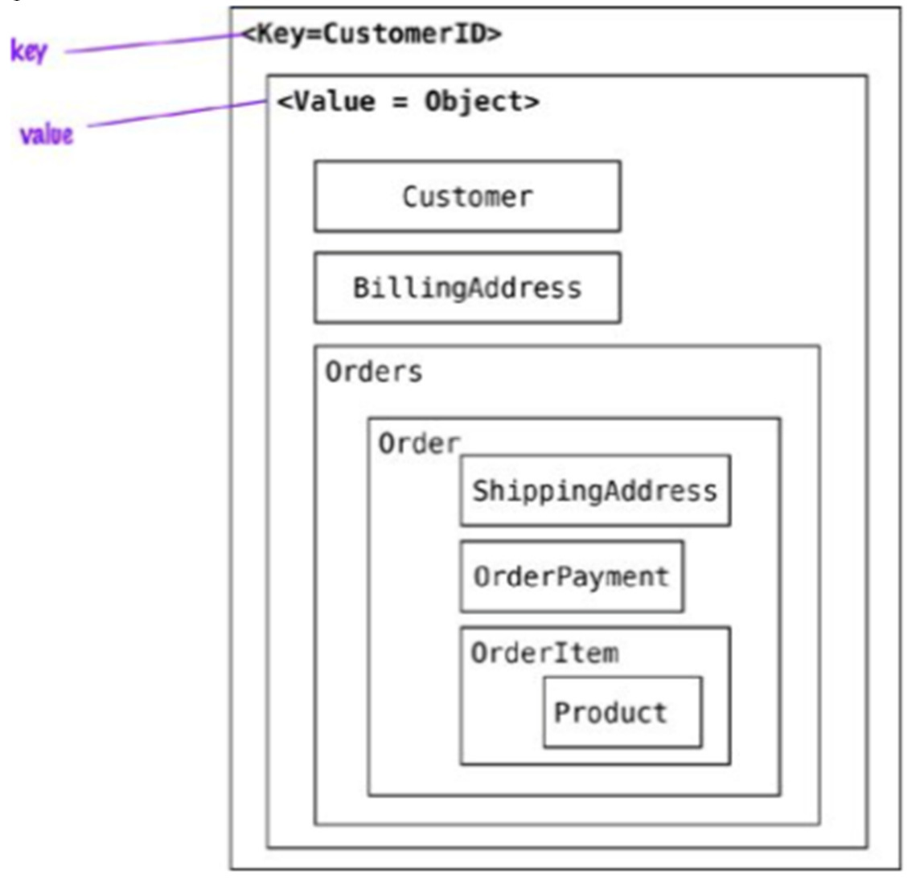
Data Modeling
When modeling data aggregates we need to consider how the data is going to be read (and what are the side effects with the chosen aggregates)
Example: Let’ s start with the model where all the data for the customer is embedded using a key-value store
The application can read the customers information and all the related data by using the key
To read the orders or the products sold in each order, the whole object has to be read and then parsed on the client side

Slide 59
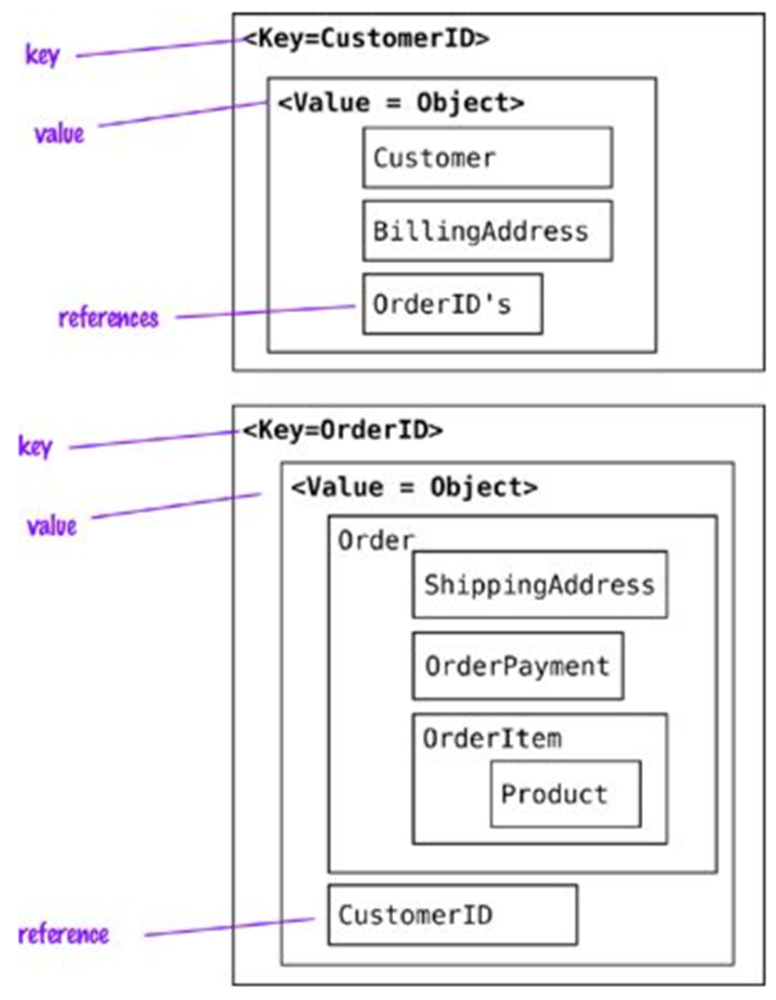
Data Modeling
When references are needed we should change the data for the key- value store to split the value object into Customer and Order objects and then maintain these objects reference
We can now find the orders independently from the Customer, and access then the customer using the CustomerID reference in the Order, whereas with the OrderId in the Customer we can find all Orders for the Customer
Using aggregates this way allows for read optimization, but we have to push the OrderId reference into Customer for every new Order

Slide 60
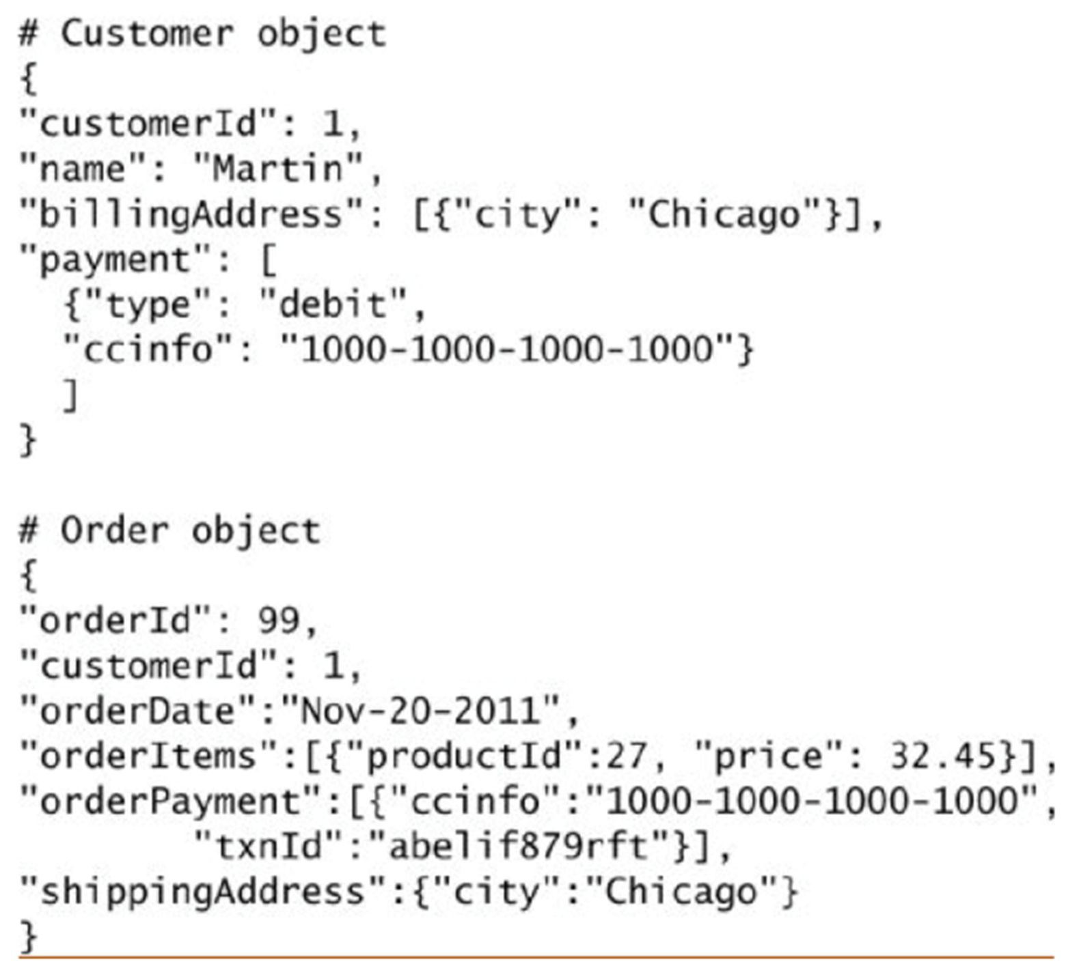
Data Modeling
In document stores, since we can query inside documents, we can find all Orders for the Customer even removing references to Orders from the Customer object. This change allows us to not update the Customer object when orders are placed by the Customer

Slide 61
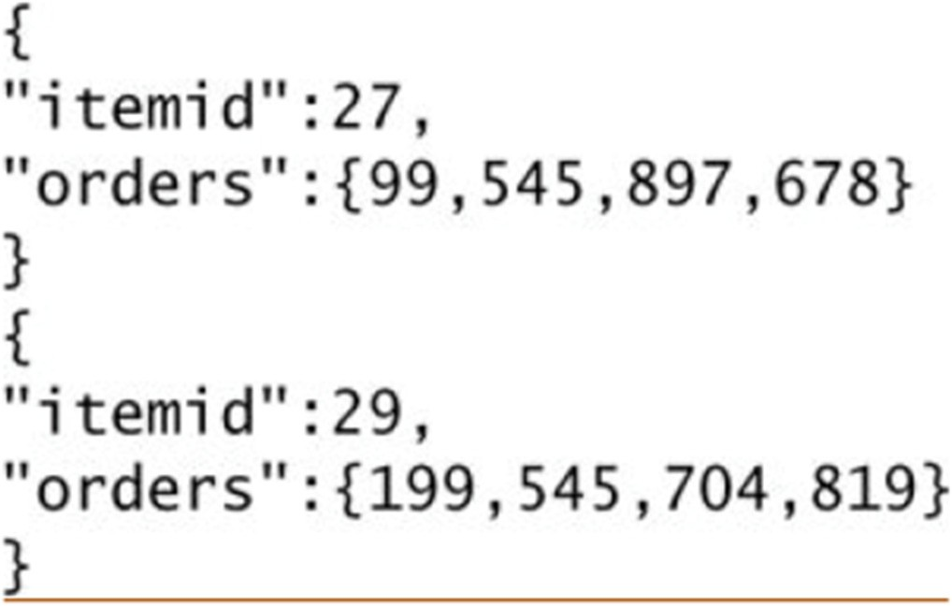
Data Modeling
Aggregates can also be used to obtain analytics; for example, an aggregate update may fill in information on which Orders have a given Product in them.
This denormalization of the data allows for fast access to the data we are interested in and is the basis for Real Time Businees Intelligence or Real Time Analytics: enterprises do not have to rely on end-of-the-day batch to populate data warehouses tables and generate analytics.
Of course, only pre-packed analyses are possible through this approach
document store modeling:

Slide 62
Data Modeling
Remark:
Since document data stores allow you to query by attributes inside the document, searches such as “find all orders that include the ‘Divina Commedia’ product” are possible
Creating an aggregate in a document store of product and orders it belongs to is therefore not necessary for obtaining the result we are looking for, but rather for optimizing the way we obtain it.

Slide 63
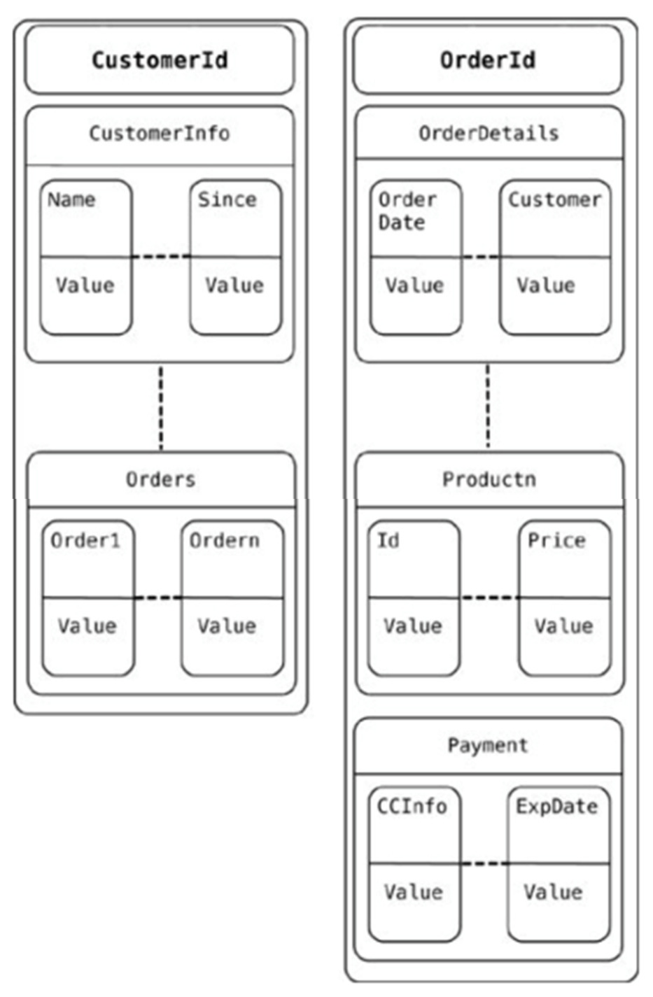
Data Modeling
When using the column families to model the data, we can model the schema a little more. Obviously, there are multiple ways to model the data
In our example, one way is to store the Customer and Order in different column families
The reference to all the orders placed by the customer are in the Customer column family. Similar other denormalizations are generally done so that query (read) performance is improved

Slide 64
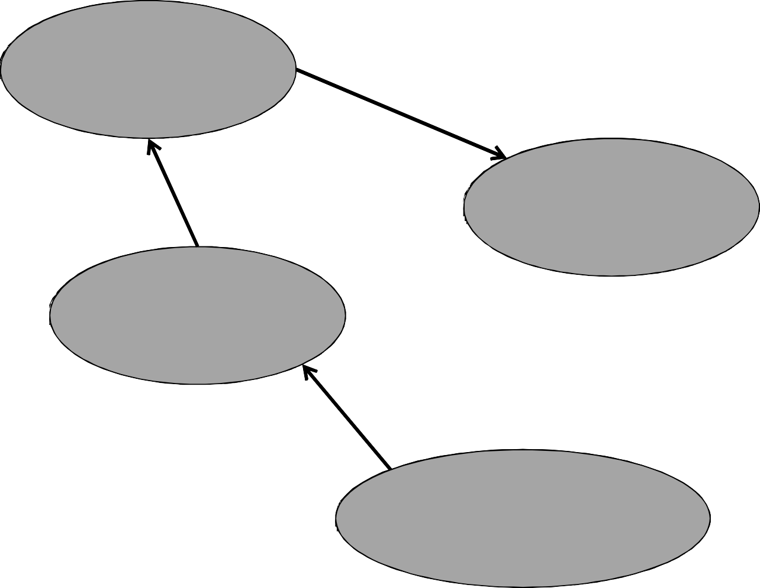
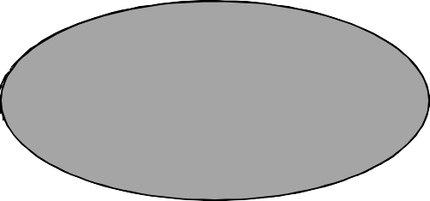
Data Modeling
When using graph databases to model the same data, we model all objects as (typed) nodes and relations within them as (typed) edges; both nodes and edges may have properties (key/value pairs). This is especially convenient when you need to use the
data to recommend products to users or to
find
1:Customer name: “Martin”
patterns in actions taken by users.
belongs_to
adress_of
purchased
ordered_by
3:Payment type: “debit” ccinfo:”1000..”
2:Address city:”Chicago”
27:Product price:32,45
payed_with txtId:”abef…”
shipped_to
contains
99:Order date:”Nov-20-2011”
Possible representation in Neo4J formalism
51

Slide 65
Consider the below given Use cases:
a) Content Management System and
b) College Library Management System.
Compare the key features of Relational Database and NOSQL Database for above given use cases and come up with the conclusion which database is suitable for these two use cases and why?

